Slide 2
Reverse Engineering Cybersecurity Workforce
Jim Smith III
Adjunct Professor -Cybersecurity Advanced Degree Fellow University of Maryland University College
Chief Executive Officer
Kinetic Potential Scholars

Slide 3
Introduction to Concept
Supply vs Demand
Reverse Engineering 21st Century Workforce
ecrofkroW ytirucesrebyC (reverse engineer)
Q & A

Slide 4
Reverse Engineering 21st Century Workforce
Phase 2: 6-14
Phase 3: 14-18
Phase 4: 18-22
Phase 5: 22-26
Career Goal:
Provide Mentorship for at risk youth
Provide Exposure and Improve academics
Leadership and Experiential Learning
Advanced Degree, Certification, Promotion
Achieve Kinetic Potential
Virtual Pipeline: Investment Banker Career Development Track (Digital Network Group)
Investment Banker
(MS)²
- DNG Proprietary and Confidential -

Slide 5
Supply vs demand

Slide 6
Mission: Supply College and Career Ready Students
Colleges: “Students are not prepared for our engineering program”
Employers: “Students lack soft skills and are unprepared for our needs”
Notes:
It’s clear that the K-12 system is not delivering on it’s mission of college and

Slide 7
Career Clusters: Begin in HS and limited to a few career options
Community Schools: Schools serve as a resource center for local community
Extended Learning: Provide additional support to students during high risk period—3pm-6pm
Notes:
It’s clear that the K-12 system is not delivering on it’s mission of college and

Slide 8
Strategic Priority: Secure human capital to meet forecasted demand
21st Century Workforce: Increasing need for highly skilled and technically savvy resources
Cybersecurity: 3.5 million unfilled jobs projected by the year 2021
`
Notes:
It’s clear that the K-12 system is not delivering on it’s mission of college and
This would make you ask the question about how many students graduate from hs each year (need to put the suppliers role into context)

Slide 9
Talent Pipeline Management: Advocated by US Chambers of Commerce Foundation https://www.uschamberfoundation.org/talent-pipeline-management
College Recruiting: Collaborating with career services and on campus events (e.g., Hackathons)
CSR: Investing in K-16 to support community—often not tied to strategic priority of securing human capital
Notes:
It’s clear that the K-12 system is not delivering on it’s mission of college and

Slide 10
Conclusion
Supply-Demand misalignment continues without collaborative effort to achieve desired outcomes
K-12 needs support to deliver on its role as “Supplier of Talent”
Employers own pipeline—must build capacity of suppliers and manage the entire system (i.e., Demand Driven)

Slide 11
Reverse Engineering 21st century workforce

Slide 12
Talent Supply Chain Solution
Community Stakeholder Model
Program Governance
Service Delivery Network
KP Professional Maturity Model

Slide 13
Reverse Engineering 21st Century Workforce
Phase 2: 6-14
Phase 3: 14-18
Phase 4: 18-22
Phase 5: 22-26
Career Goal:
Provide Mentorship for at risk youth
Provide Exposure and Improve academics
Leadership and Experiential Learning
Advanced Degree, Certification, Promotion
Achieve Kinetic Potential
Virtual Pipeline: Investment Banker Career Development Track (Digital Network Group)
Investment Banker
(MS)²
- DNG Proprietary and Confidential -

Slide 14
Youth & Workforce Development Stakeholders
(MS)²
14
- Proprietary and Confidential -
14
Notes:
Fragmented supplier marketplace
Overlapping customer base
Limited collaboration amongst groups
No central infrastructure
Inefficient approach for meeting student needs

Slide 15
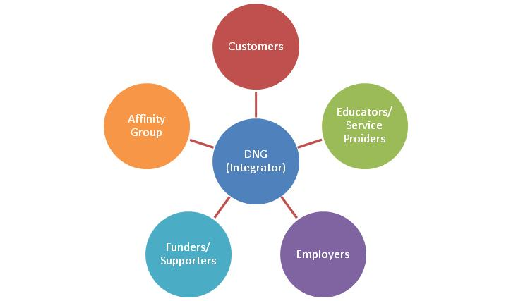
Integrate Stakeholders Into Service Delivery Network
Community Stakeholder Model
Identifies the stakeholders and delineates by organizational type
Defines roles and expectations to facilitate collaborative partnership
KP
Providers
- Proprietary and Confidential -
Notes:
The colors don’t correspond directly to the pipeline—would need to remake this slide to match colors (and also update DNG t/b KP)

Slide 16
Service Delivery Network
CUSTOMERS:
Schools
Faith Based Orgs
Government Org.
EMPLOYERS:
Corporations
Academia
Government
Funders / Policy
Service Providers / Educators
Individuals / Affinity Groups

Slide 17
KP PMM | Proficiency Level
Executive / Master | Expert
Manager / SME | Advanced
Professional | Intermediate
Apprentice (College or OJT Program) | Novice
Intern (High School) | General Awareness
Cadet (Middle School) | Limited Awareness
Scout (Elementary School) | Introduced
KP Professional Maturity Model

Slide 18
KP Professional Maturity Model
 |  | 0-500 | 600-800 | 900-1200 | 1300-1600
Workforce Skill | Proficiency Level | Scout (ES) | Cadet (MS) | Intern (HS) | Apprentice
Communication
Introduced | 1 | 0-80 | 600-640 | 900-955 | 1300-1355
Lim Awareness | 2 | 80-160 | 640-680 | 955-1010 | 1355-1410
Gen Awareness | 3 | 160 - 240 | 680-720 | 1010-1065 | 1410-1465
Novice | 4 | 240 - 320 | 720-760 | 1065-1120 | 1465-1520
Intermediate | 5 | 320 - 400 | 760-800 | 1120-1175 | 1520-1575
Advanced | 6 | 400 - 480 | 800-840 | 1175-1230 | 1575-1630
Expert | 7 | 480 - 600 | 840-900 | 1230-1300 | 1630-1600

Slide 19
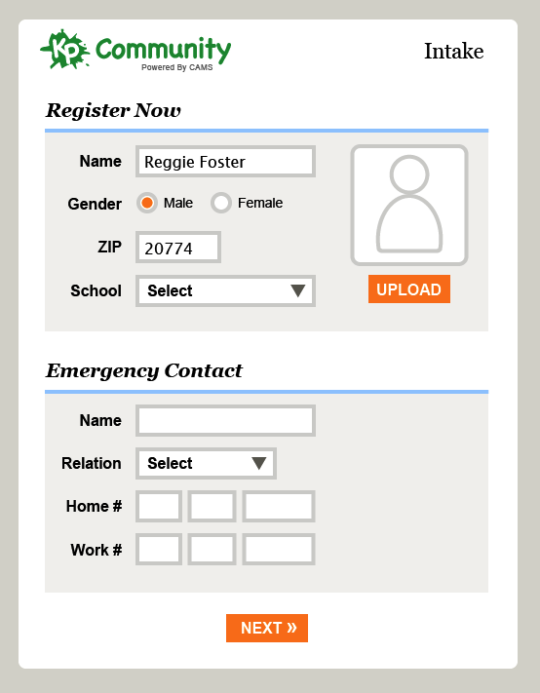
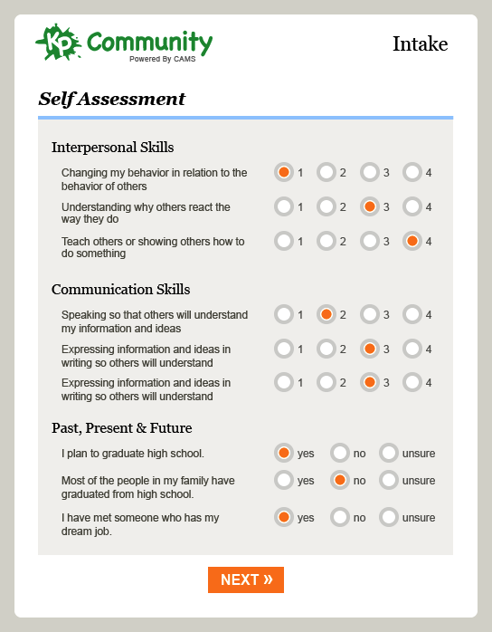
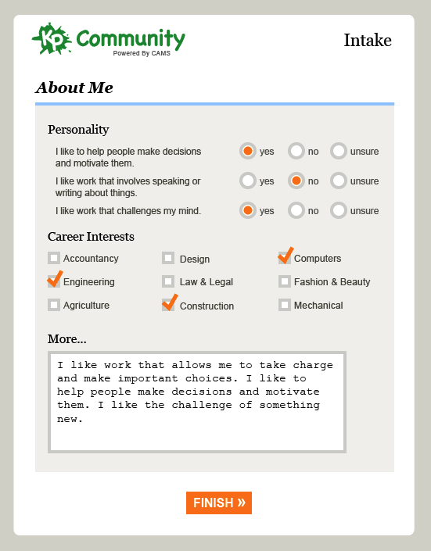

Slide 21
Professional

Slide 22
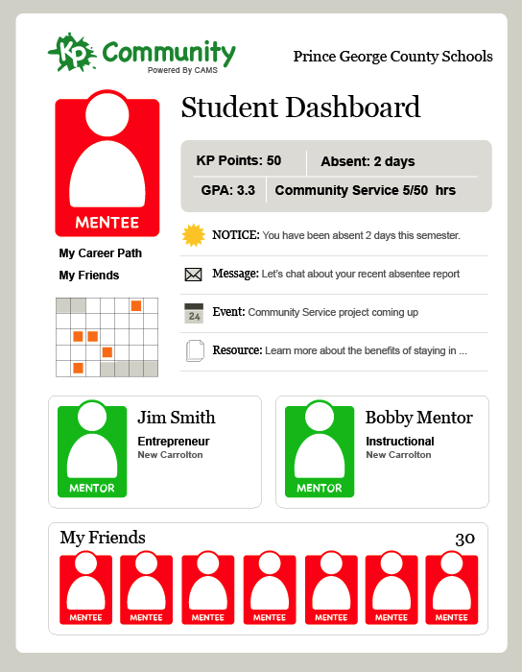
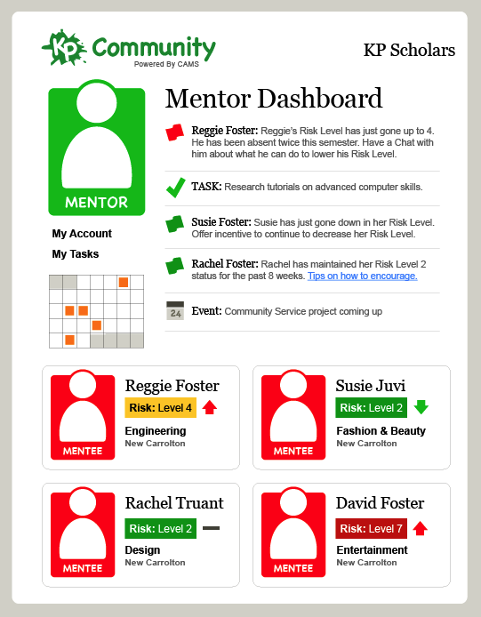

Slide 23
ecrofkroW ytirucesrebyC
Reverse Engineer

Slide 24
Vulnerability Assessment & Management
A0001: Ability to identify systemic security issues based on the analysis of vulnerability and configuration data.
A0044: Ability to apply programming language structures (e.g., source code review) and logic.
A0120: Ability to share meaningful insights about the context of an organization’s threat environment that improve its risk management posture.
A0123: Ability to apply cybersecurity and privacy principles to organizational requirements (relevant to confidentiality, integrity, availability, authentication, non-repudiation).
Analyze
Collect and Operate
Investigate
Operate and Maintain
Oversee and Govern
Protect and Defend
Defense Analysis
Defense Infrastructure Support
Incident Response
* Vulnerability Assessment & Management
Securely Provision
https://niccs.us-cert.gov/workforce-development/cyber-security-workforce-framework

Slide 25
Vulnerability Assessment & Mgmt | Intern (13-17) (Awareness) | Apprentice (17-21) (Novice) | Professional (21-27) (Intermediate)
A0001 | 900-1200 | 1300-1600 | 1700-2200
A0044 | 900-1200 | 1300-1600 | 1700-2200
A0120 | 900-1200 | 1300-1600 | 1700-2200
A0123 | 900-1200 | 1300-1600 | 1700-2200

Slide 26
Vulnerability Assessment Analyst
National Security Agency, MD
CSA+
Professional
Network + Certification
A+ Certification
Security + Certification

Slide 27
Integrate Stakeholders Into Service Delivery Network
PGCPS BCPS
UMD PGCC
UPENN JHU
CyberPatriots NICE Challenge
NSBE
KP
Providers
NSA MS Comp TIA
PGCPS BCPS
MSDE (ESSA) PGEDC-WDS (WIOA) PGC Council
- Proprietary and Confidential -
Notes:
The colors don’t correspond directly to the pipeline—would need to remake this slide to match colors (and also update DNG t/b KP)

Slide 28
Q&A
Jim Smith III CADF Fellow
Adjunct Professor, UMUC
CEO, Kinetic Potential Scholars
Jim.Smith@faculty.umuc.edu
O: 301.883.8256
C: 240.417.5111

Slide 29
Operational execution

Slide 30
K12 Extended Learning Day (out-of-school time)
168 Hrs (Academic) + 56 Hrs (Social) = 112 Hrs (Professional) = 336 Hrs

Slide 31
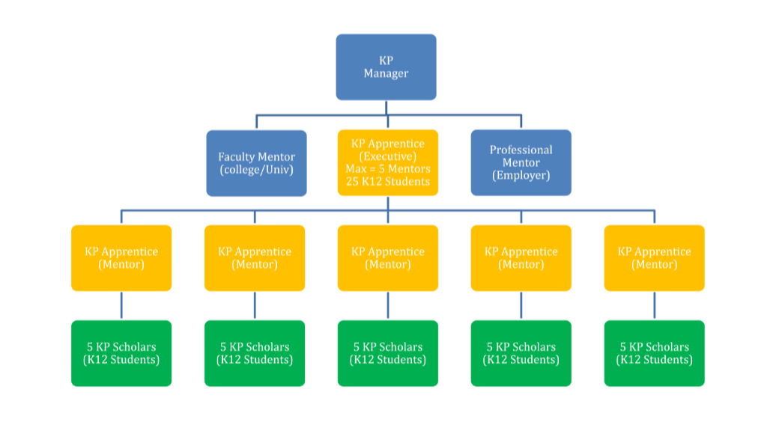
KP 21st Century Community Learning Center Delivery Model

Slide 32
Intern (Aware)
Module 1: * Basic Learning Skills
Module 2: * IT Basics * Modeled on Comp TIA A+ Program
Apprentice (Novice)
Module 3: * Workstations/Servers/ Networks
Module 4: * Networks / System Admin
Module 5:
* Admin/IT Security/Cyber
Professional (Intermediate)
Module 6: * Security Ops/Cyber Review / Tools
Module 7: * Hands on Cyber Range * Practice Handling Real World Threats
Baltimore Cyber Range (https://www.baltimorecyberange.com/)

